Slide 1
Clinically useful early detection of Parkinson's Disease using uncertainty-aware classification with CNNs
Master Thesis
Presented By: Anurag Sundar
Supervised by: Dr. Markus Wenzel

Slide 2
Goal of the thesis
Construction of an uncertainty-aware CNN(Convolutional Neural Network) model for early Parkinson’s disease detection.
Uncertainty-aware: Calculation and display of uncertainty metrics for each prediction. The model should be distance aware.
Predicting the Specific Binding Ratio(SBR) from SPECT images for each case.

Slide 3
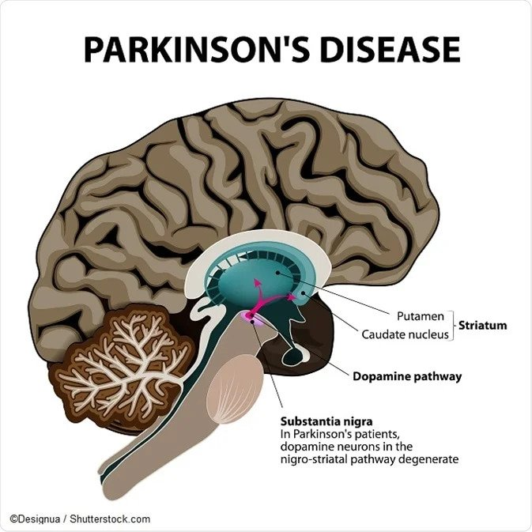
What is Parkinson’s Disease?
Parkinson’s disease affects the Central nervous system causing degeneration of mental and motor functions.
Parkinson’s Disease is caused by the malfunction of an area of the brain called Substantia Nigra.
Dopamine is a neuroendocrine transmitter produced in the Substantia Nigra that affects movement, motivation, and pleasure in the human brain.
Malfunction of the Substantia Nigra causes loss of dopaminergic cells which leads to reduced dopamine production and activity.
Hence, leading to Parkinson’s disease.

Slide 4
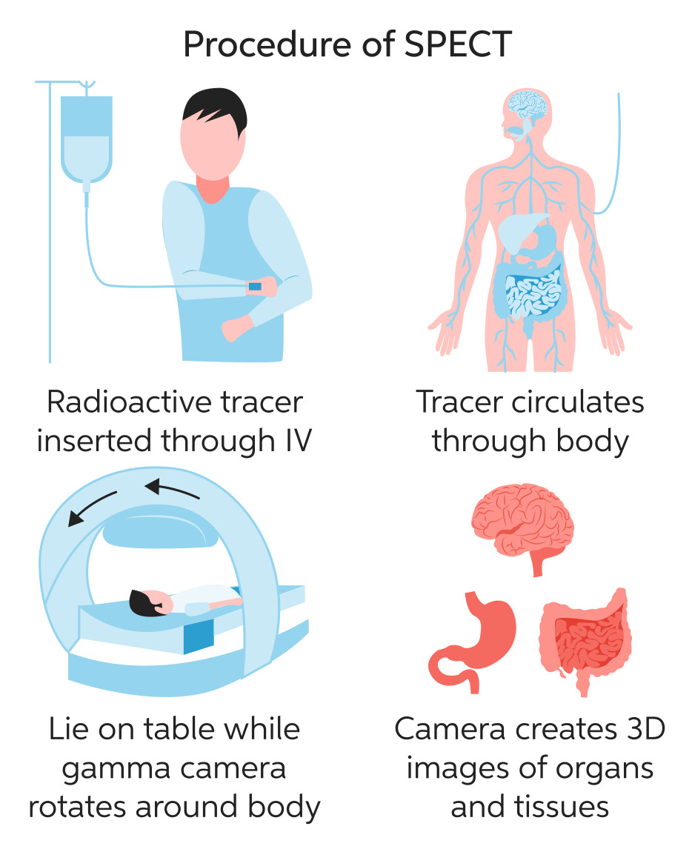
FP-CIT SPECT Scan
FP-CIT: N-ω-fluoropropyl-2β-carbomethoxy-3β-(4-I- 123-iodophenyl)nortropane(Radioactive Tracer)
FP-CIT is injected into the blood, where it circulates around the body and makes its way into the brain. It attaches itself to the dopamine transporter, a molecule found on dopamine neurons. Several hours after the tracer has been injected, special imaging equipment scans the head to detect the presence of the dopamine transporter via SPECT.
SPECT(Single photon emission computed tomography) is a non-invasive nuclear medicine test that shows brain function.
In the data for this study, SPECT scans have been used to detect the presence and activity of the dopamine transporter in the Striatum.
This scan is then usually analysed by healthcare providers to detect Parkinson’s disease.

Slide 5
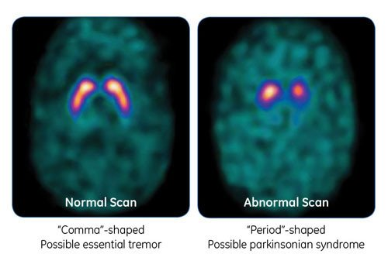
Parkinson’s disease detection
Shows difference in activity of dopamine transporter between Normal and Abnormal scan.
Area of the brain: Striatum
Normal: Comma shaped(LEFT)
Abnormal: Period shaped(RIGHT)

Slide 6
What/ How is the data?
2D and 3D brain scan images from Universitätsklinikum Hamburg-Eppendorf(UKE) and Parkinson’s Progression Marker Initiative(PPMI)Study.
Some smoothened images and some not smoothened images.
2D image dimension: (109,91)
3D image dimension: (91,109,91)
Specific binding ratio(SBR) for each image.

Slide 7
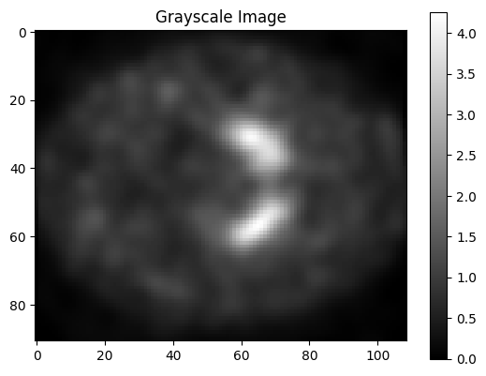
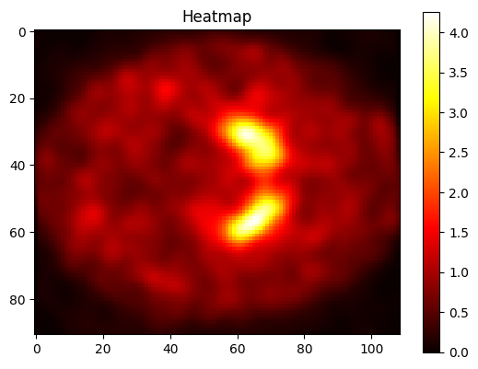
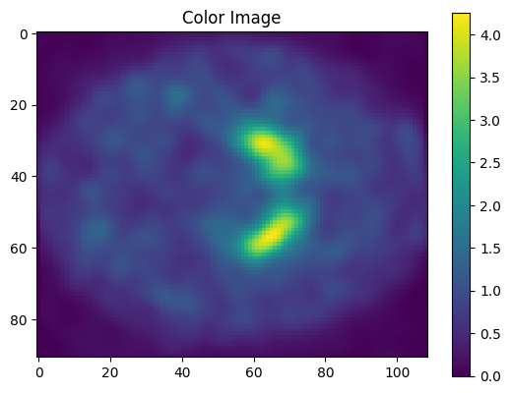
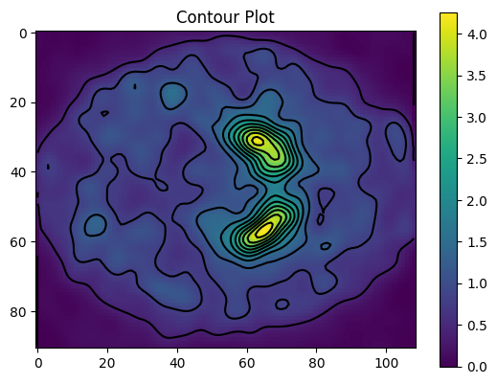

Slide 8
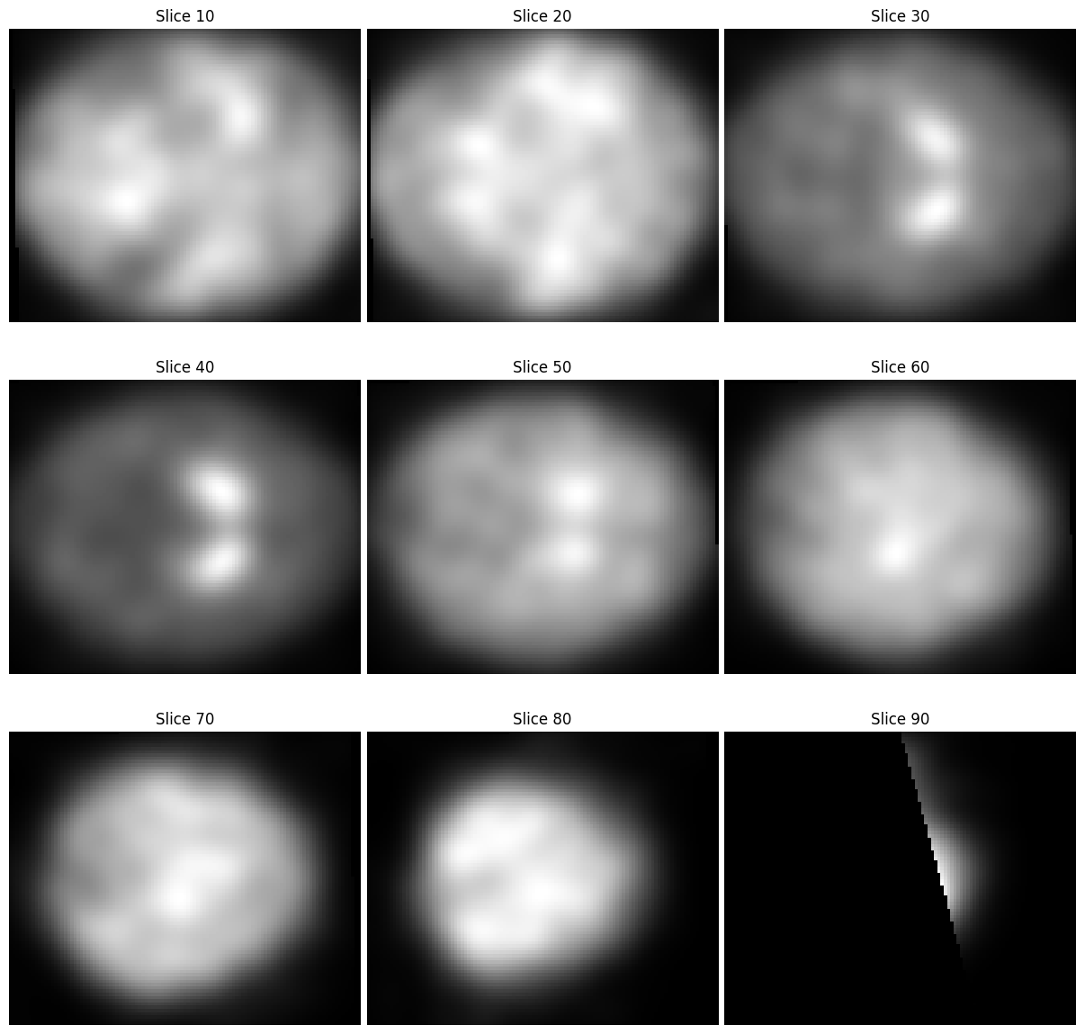

Slide 9
Why CNNs for medical image classification?
CNNs are excellent feature extractors.
Use of CNNs helps avoiding expensive feature engineering tasks.
CNN based neural networks are widely used in medical image classification tasks.

Slide 10
Uncertainty-aware techniques:
Proposed:
Spectral-Normalised Neural gaussian Process(SNGP)
Standard benchmarks:
Monte Carlo Dropout
Deep Ensemble

Slide 11
SNGP(Spectral-normalized Neural Gaussian Process)
SNGP improves a Deep Classifier’s distance awareness.
“A model's distance awareness is a measure of how its predictive probability reflects the distance between the test example and the training data.”[2]
It helps improve a Deep Classifier’s uncertainty quality while maintaining a similar level of accuracy and latency.

Slide 12
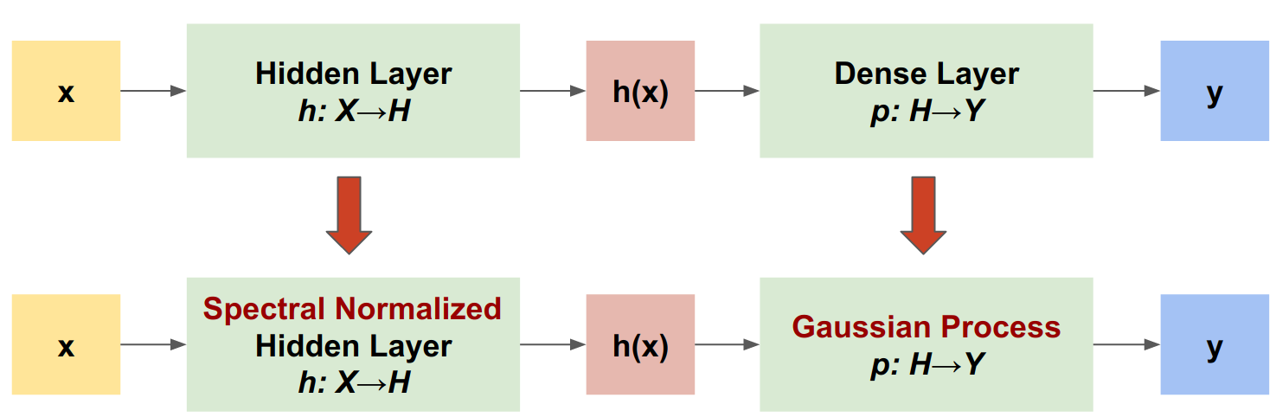
SNGP Procedure
SNGP procedure outline:
Applying Spectral Normalisation to Hidden Layers.
Replacing the Dense output layer with a Gaussian Output Layer.

Slide 13
Specific Binding Ratio
The Specific Binding Ratio (SBR) is calculated as the ratio of specific binding in the striatum, a region associated with dopamine function, to nonspecific binding in a reference region.
It is a measure used to assess the loss of dopamine transporters in the brain.
A lower Specific Binding Ratio (SBR) is often observed due to the loss of dopamine transporters in the striatum. This reduction in SBR can be indicative of the degenerative changes associated with Parkinson's disease and can assist in the diagnosis and monitoring of the condition.

Slide 14
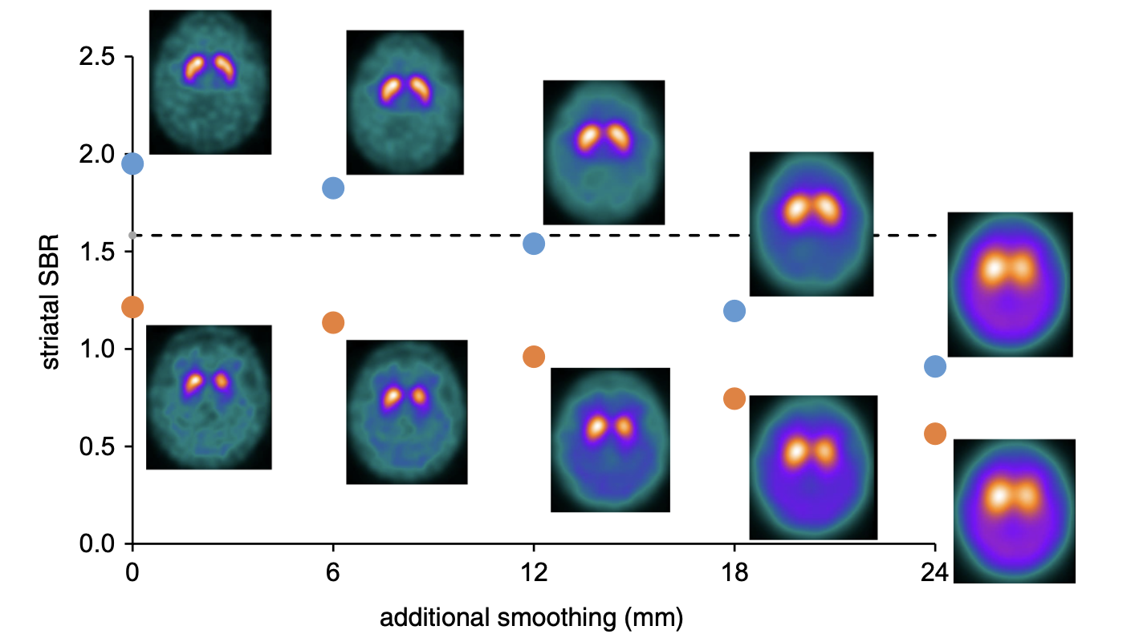
SBR threshold at different stages of smoothening [6]

Slide 15
Applications
Decision Support: Uncertainty-aware models can serve as decision support tools for healthcare professionals.
Early Detection: Early parkinson’s disease detection in uncertain cases.
Risk Assessment: Risk assessment based on uncertainty of prediction.
Robustness to Noisy/Incomplete data: Uncertainty estimates can be made even for incomplete or noisy data.

Slide 16
References
[1] American Parkinson’s disease association: https://www.apdaparkinson.org/article/what-is-a-datscan-and-should-i-get-one/
[2] Uncertainty-aware Deep Learning with SNGP: https://www.tensorflow.org/tutorials/understanding/sngp
[3] https://pubmed.ncbi.nlm.nih.gov/22529704/
[4] https://www.researchgate.net/figure/TRODAT-1-SPECT-image-of-healthy-volunteer-control-demonstrating-ROI-analysis-for_fig1_8036468
[5] https://www.news-medical.net/health/Parkinsons-Disease-Pathophysiology.aspx
[6] Automatic classification of dopamine transporter SPECT: deep convolutional neural networks can be trained to be robust with respect to variable image characteristics

